Slide 1

Help your child with maths
21.2.2017
“Thinking is at the heart of Mathematics and therefore should be at the heart of mathematical teaching and learning.”

Slide 2
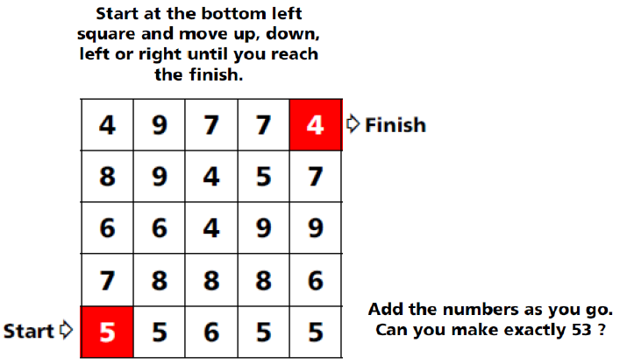

Slide 3
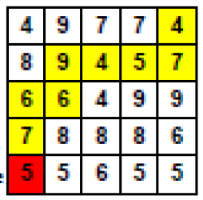
Here is one solution…

Slide 4
Aims:
Talk to your children about maths.
Understand how we teach calculation.
Greater understanding of progression throughout the whole school – calculation policy.

Slide 5
The New Maths Curriculum
Children should:
Become fluent in the fundamentals of mathematics, including through varied and frequent practice with increasingly complex problems over time, so that pupils develop conceptual understanding and the ability to recall and apply knowledge rapidly and accurately.
Reason mathematically by following a line of enquiry, conjecturing relationships and generalisations and developing an argument, justification or proof using mathematical language.
Solve problems by applying their mathematics to a variety of problems with increasing sophistication, including breaking down problems into a series of simpler steps and persevering in seeking solutions.

Slide 6
MATHS AT BLEDINGTON PRIMARY SCHOOL
Mental maths (maths passport) and mental strategies
Skills ladders available on the website
Problem solving taught discretely
Written methods for +, - , x and ÷

Slide 7
What is a calculation policy and why do we need one?
The National Curriculum 2014 states which calculation methods the pupils should be using at the end of each key stage.
Emphasis on the use of formal calculation methods by the end of Year 6.
Our Calculation Policy gives a clear pathway showing the route pupils will take to help them master the calculation methods.
Adults, both at home and at school, who support children are working towards the same goals, using the same methods.

Slide 8
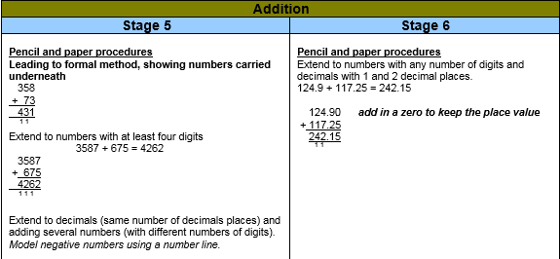
PLACE VALUE… (ITS VITAL!!!)
Place value is at the heart of the number system. All digits have a value and a secure understanding of this will enable children to use and understand different calculation methods.
Why cant we just teach children this…?

Slide 9
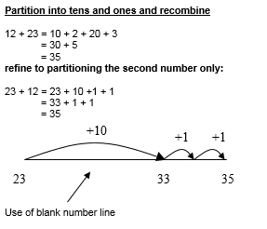
PLACE VALUE… (ITS VITAL!!!)
We must place the foundations for a thorough understanding of the number system which will allow children to use formal written methods as they progress through school.
We do this through partitioning and ensuring that children understand the value of a digit.

Slide 10
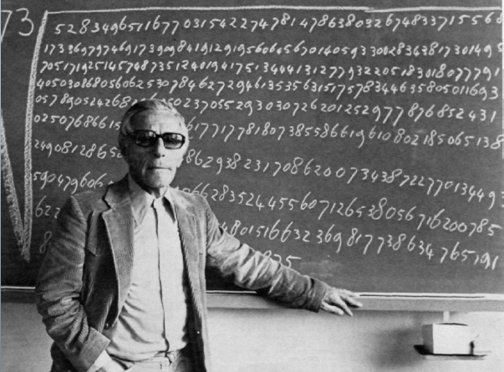
Calculating with Understanding
What is the answer to:
247 + 99 =
The first question children should ask is can I do this in my head?
32469 – 9998 = 10378 + 101 =
£165.30 - £1.99 =

Slide 11
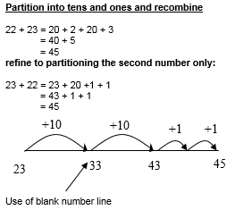
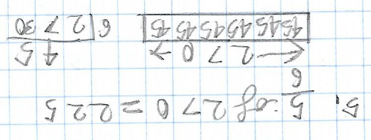

NUMbER LINES… WHY?
If you can see it.. You can understand it..
Number line example for addition taken from calculation policy
Number line example used in Y6 for fractions

Slide 12
Can I do it in my head?
The number line builds mental dexterity so children will come off the number line and solve sums mentally
48 x 24 = 48 x 20 = 960
48 x 2 = 96 = 48 x 4 = 96+96
100 +100 - 8 = 192
960 + 192 = 960+200-8 = 1152

Slide 13
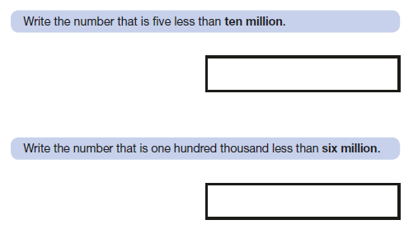


Slide 14
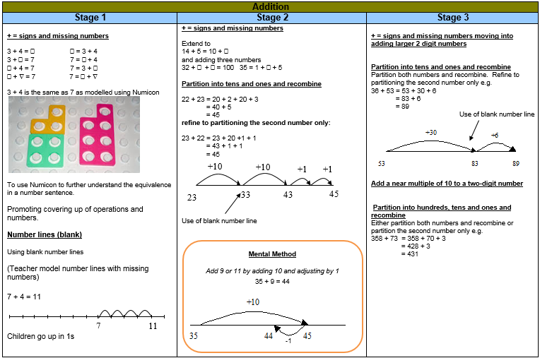
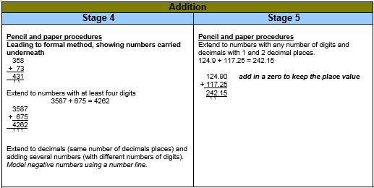
ADDITION
The mental methods that lead to column addition generally involve partitioning, e.g. adding the tens and units separately, often starting with the tens as this is the larger part of the number. They can also include the use of number lines, tracks and squares for counting on.

Slide 15
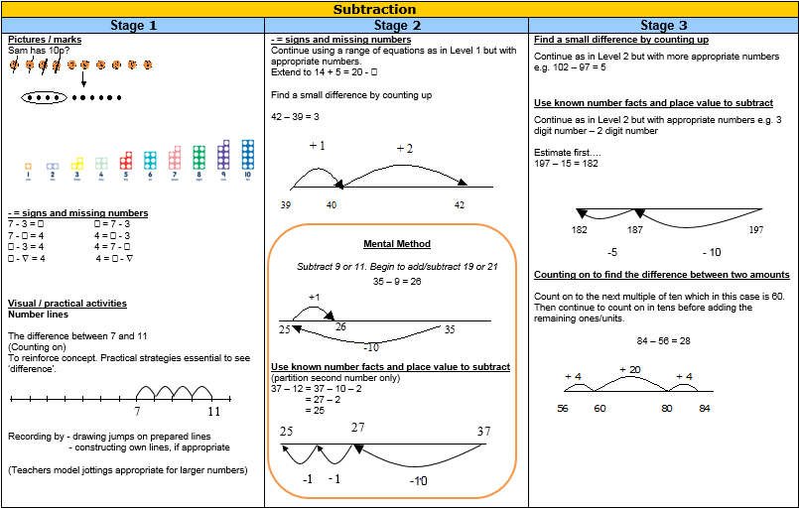
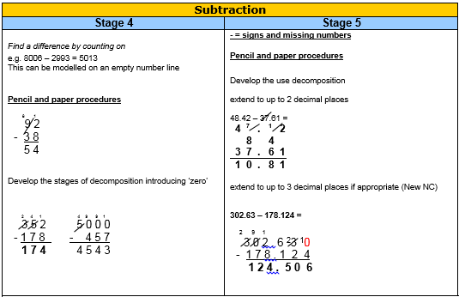
SUBTRACTION
Mental methods should involve counting back in single digit numbers, leading onto counting back in multiples of 10, possibly using a number square. Children find subtraction difficult particularly when they are introduced to column methods at an early stage when they are not ready for it. With continued practise and reinforcement, children will become very comfortable using counting on methods on a number line.

Slide 16
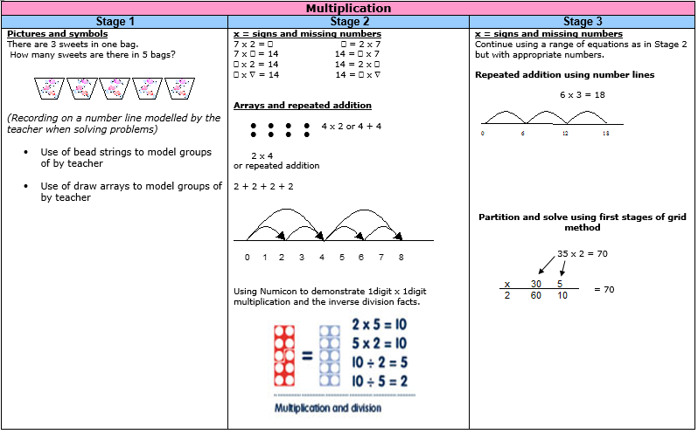
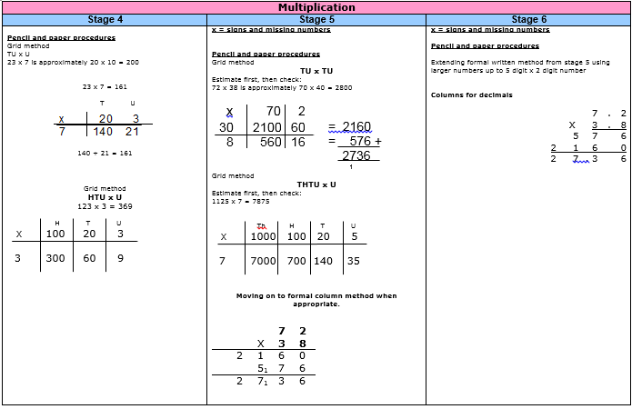
MULTIPLICATION
Early stages of multiplication will focus on groups and sets, leading onto the learning of multiplication tables facts up to 12 x 12. Most children should have a secure knowledge of all multiplication facts by the end of Year 4.

Slide 17
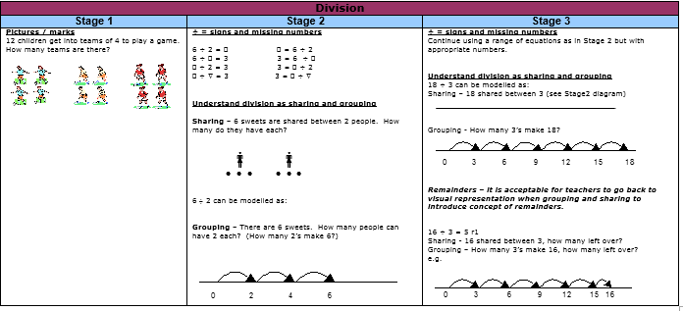
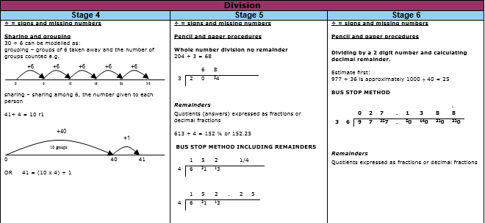
DIVISION
Using written methods for division can be the most difficult for children. Early mental approaches should involve grouping and sharing. Discussing the sharing out of sweets is an example. When there are some left over, the term remainder can be introduced.

Slide 18
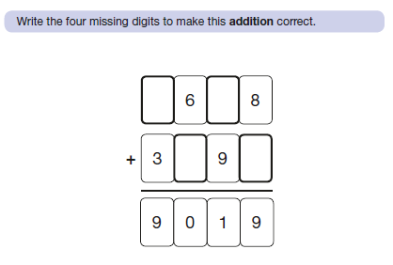

Slide 19
SOMETHING TO THINK ABOUT…
Although our policy shows progression across year groups, as recommended by the National Curriculum 2014, it is important to remember that all children are different.
It may be that some children work through the stages of calculation at a different pace to their peers.
We will tailor our teaching to help pupils become confident mathematicians.

Slide 20
DO WE TEACH ‘THE PROPER WAY?’
Yes but only when the children are fully conversant with the numerical principles underpinning the standard algorithms
They are taught them because:
They should be taught a range of strategies
They will be introduced to these in Key Stage Two.
However the children tend to leapfrog the traditional written methods as they develop efficient mental strategies of their own…

Slide 21
HOW CAN YOU HELP YOUR CHILD?
Times tables – it is vital that children have a good recall of times tables.
By the end of Year 2 – children are expected to know the 2, 5 and 10 times tables.
By the end of Year 3 – children also need to know the 3, 4 and 8 times tables.
By the end of Year 4 it is expected that children will know all of the tables up to 12 x 12.

Slide 22
HOW CAN YOU HELP YOUR CHILD?
Encourage children to show you, and use, the methods they have been taught for written calculations when completing homework.
Continue to talk about numbers with your child so that they can see how maths is used outside of school in the real world!
Talk to your child’s teacher if you have any concerns about your child’s work.

Slide 23


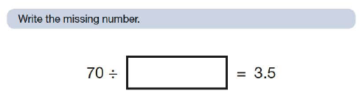
Year 6 age expected questions

